Slide 1

Basic Details of the Team and Problem Statement
Ministry/Organization Name/Student Innovation:
PS Code: SIH1450
Problem Statement Title: Develop and deploy a Large Language model (LLM)Based tool for generating human like responses to natural language inputs for network not connected over internet
Team Name: Team Kanya Rashi
Team Leader Name: Malavika Joshi
Institute Code (AISHE):
Institute Name: J.B. INSTITUTE OF ENGINEERING & TECHNOLOGY
Theme Name: Large Language Model

Slide 2
Idea/Approach Details
Giving “human” responses to natural language inputs
Producing responses for questions without the need for an internet connection
Providing a stable platform .
Managing huge amounts of domain specific datasets.
Accurate Response through texts
It not only provides educational information but also connects with user deeply.

Slide 3


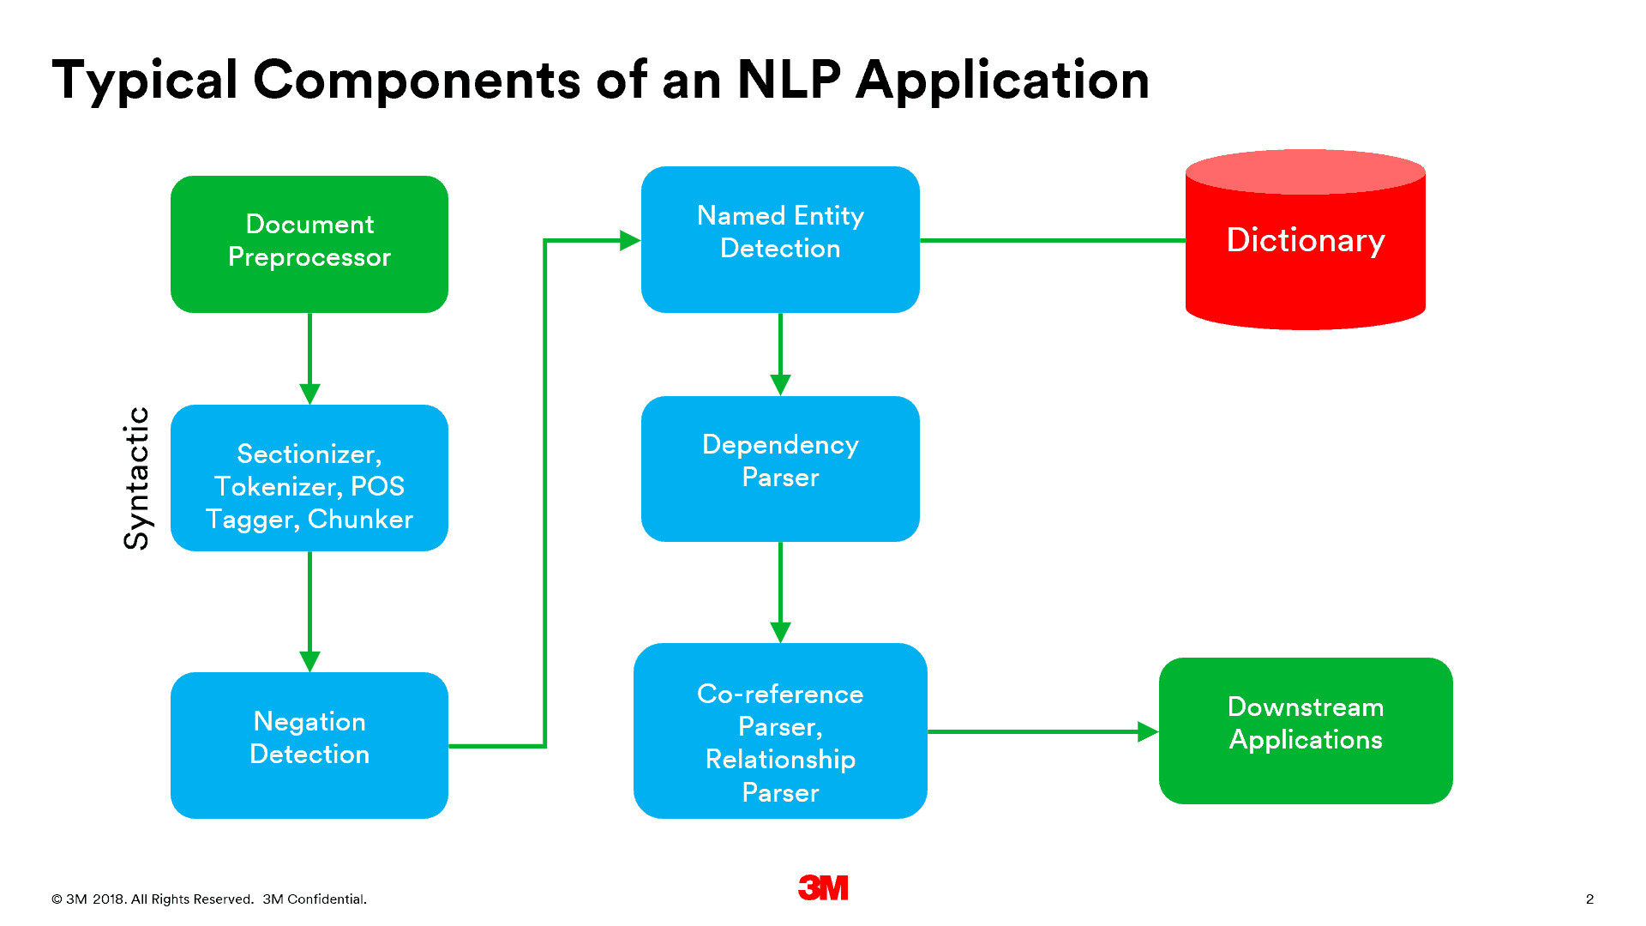
TECHNOLOGY STACK
PYTHON: Back-end code development
HTML & CSS: Front-end website development
WE HAVE USED
Natural language processing(NLP)
Natural language understanding(NLU)
Large Language Model(LLM)

Slide 4
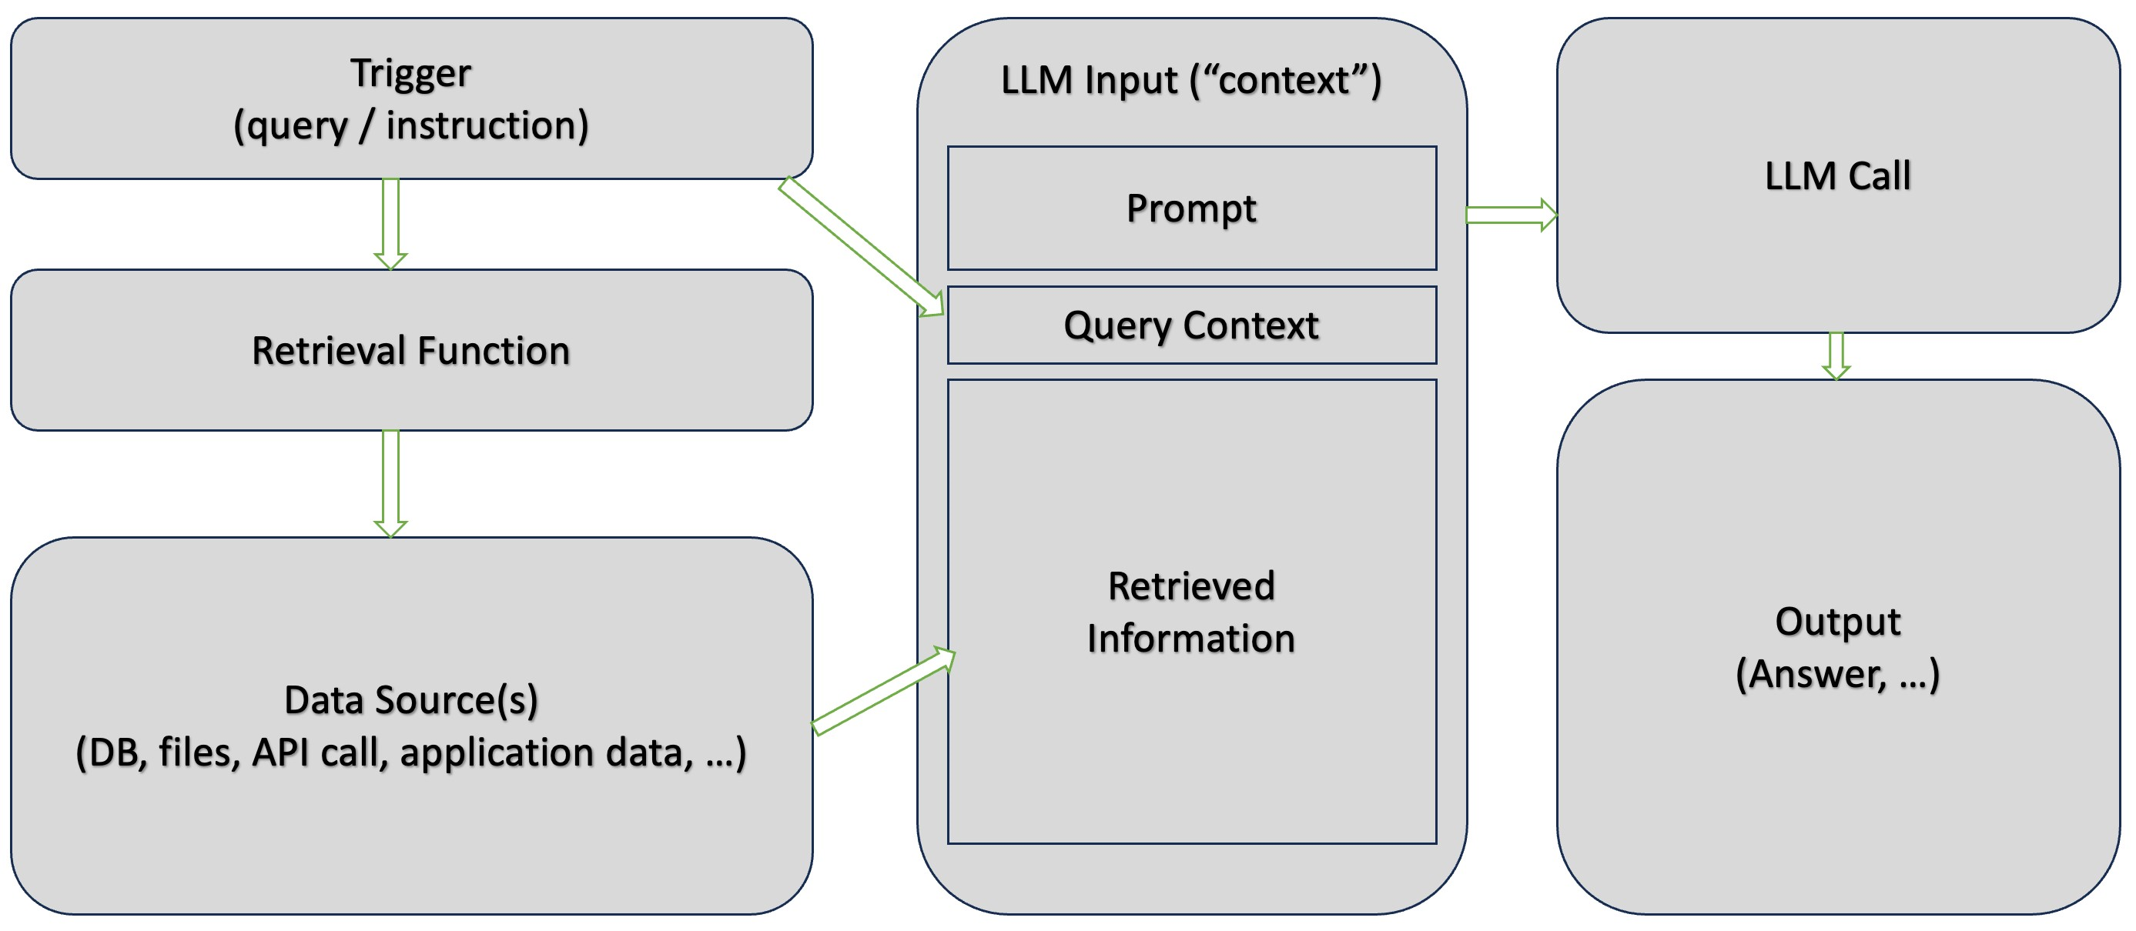
PROCESS FLOW

Slide 5
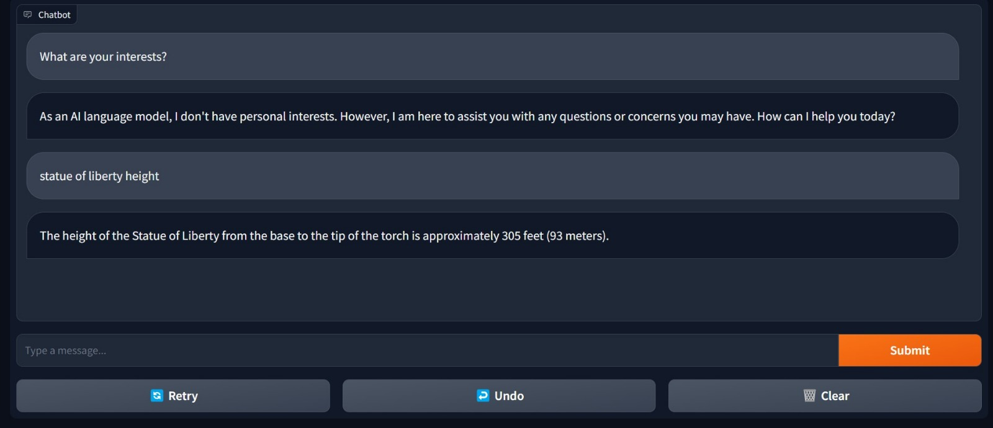
output

Slide 6
CONCLUSION
A text-text chatbot is created which provides any information in fraction of seconds. This platform is easily accessible to every individual . That chatbot can accept common texting language and provide us with required output. This can clarify any type of question and queries without any glitch.

Slide 7
Team Member Details
Team Leader Name: Malavika Joshi
Branch :Btech Stream :AIML Year (I,II,III,IV): III
Team Member 1 Name: Rallapalli Lakshmi Chandana
Branch :Btech Stream :AIML Year (I,II,III,IV): III
Team Member 2 Name: Shada Manogna
Branch :Btech Stream :AIML Year (I,II,III,IV): III
Team Member 3 Name: Kakarla Bharadwaj Sai
Branch : Btech Stream : AIML Year (I,II,III,IV): III
Team Member 4 Name: Bhadram Srimannaryana Sarvabhowma
Branch : Btech Stream :AIML Year (I,II,III,IV):III
Team Member 5 Name: Macha Shashank
Branch : Btech Stream :AIML Year (I,II,III,IV):III

